Slide 1


Computer Organization & Architecture
Chapter 15
Control Unit Operation

Slide 2
16.1 Micro-Operations
A computer executes a program in many instruction cycles, typically, an instruction/cycle
  Fetch/execute sub-cycles
  Each sub-cycle has a number of steps
These steps are called micro-operations, see Fig.16.1
Each step is simple and does very little, atomic operation of CPU
Micro-operations are the atomic operations of a processor

Slide 3
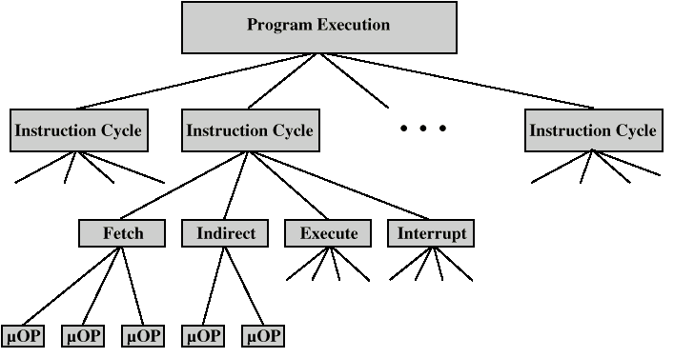
Constituent Elements of Program Execution

Slide 4
Fetch Cycle
  Access PC, PC contains address of next instruction
  Address moved to MAR
  Address placed on address bus
  Control unit requests memory read
  Result placed on data bus, copied to MBR
  Then, to IR
  MBR is now free for further data fetches
  Meanwhile PC incremented by I
    (in parallel with data fetch from memory)

Slide 5
Fetch Sequence (symbolic)
  t1: MAR ← (PC)
  t2: R ← 1, MBR ← (memory)
  PC ← (PC) +I
  t3: IR ← (MBR)
  (tx = time unit/clock cycle, a clock pulse)
  t1: MAR ← (PC)
  t2: R ← 1, MBR ← (memory)
  t3: PC ← (PC) +I
  IR ← (MBR)

Slide 6
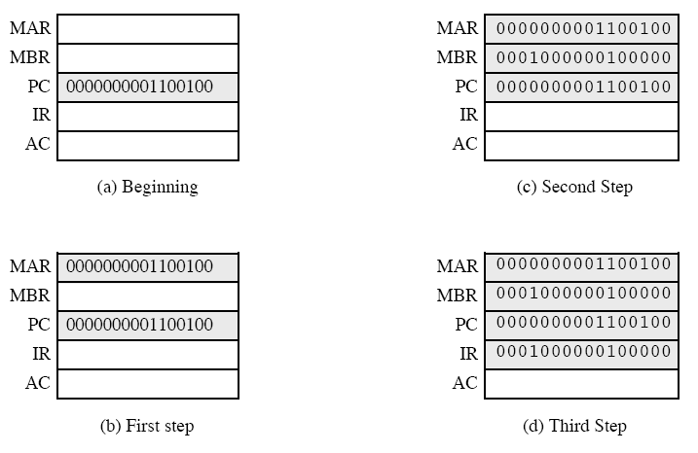
Sequence of Events, Fetch Cycle
1

Slide 7
Rules for Clock Cycle Grouping
  Proper sequence must be followed
    MAR ← (PC) must precede MBR ← (memory)
  Conflicts must be avoided
    Can not read & write same register at same time
    MBR ← (memory) & IR ← (MBR) must not be in same cycle
  Also: PC ← (PC) +I involves addition
    Use ALU
    May need additional micro-operations

Slide 8
Indirect Cycle
  t1: MAR ← (IR_{address}) - address field of IR,
  t2: R ← 1, MBR ← (memory)
  t3: IR_{address} ← MBR
  MBR contains an address for operand
  IR is now in same state as if direct addressing had been used

Slide 9

Data Flow -- Indirect Diagram

Slide 10
Interrupt Cycle
  t1: MBR ←(PC)
  t2: MAR ← save-address,
  PC ← routine-address
  t3: W ← 1, memory ← (MBR)
  This is a minimum
    May be additional micro-ops to get addresses
    Note, saving context is done by interrupt handler routine, not micro-ops

Slide 11
Execute Cycle
  Different for each instruction
    e.g. ADD R1,X
      add the contents of location X to Register 1 , result in R1
  t1: MAR ← (IRaddress)
  t2: R ← 1, MBR ← (memory)
  t3: R1 ← R1 + (MBR)

Slide 12
Execute Cycle (ISZ)
  ISZ X - increment and skip if X=0
    t1: MAR ← (IR_{address})
    t2: R ← 1, MBR ← (memory)
    t3: MBR ← (MBR) + 1
    t4: W ← 1, memory ← (MBR)
    if (MBR) == 0 then PC ← (PC) + I
  Notes:
    “if clause” is a single micro-operation
    Micro-operations done during t4

Slide 13
Executing Cycle (BSA)
  BSA X - Branch and save address
    Address of instruction following BSA is saved in X
    Execution continues from X+I
    Used for Subroutine call
    t1: MAR ← (IR_{address})
    MBR ← (PC)
    t2: W ← 1, memory ← (MBR)
    PC ← (IR_{address})
    t3: PC ← (PC) + I

Slide 14
Instruction Cycle
  Each phase of the instruction cycle can be decomposed into a sequence of elementary micro-operations
  In Fig.16.3, a new 2-bit register called the instruction cycle code (ICC) is assumed
  ICC=
    00: fetch
    01: indirect
    10: execute
    11: interrupt

Slide 15
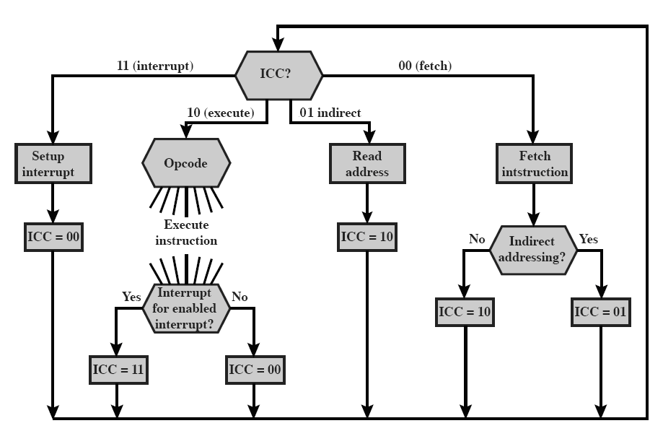

Slide 16
16.2 Control of The Processor
In order to describe the control unit, first, we must know
  basic elements of processor
  micro-operations that processor performs
  functions that control unit must perform

Slide 17
Basic Elements of Processor
  ALU
  Registers
  Internal data paths
  External data paths
  Control Unit

Slide 18
Types of Micro-operation
  Data transfer
    Transfer data between registers
    Transfer data from register to external
    Transfer data from external to register
  Perform arithmetic or logical ops

Slide 19
Functions of Control Unit
  Sequencing
    The control unit causes the processor to step through a series of micro-operations in the proper sequence
  Execution
    The control unit causes each micro-operation to be performed
    This is done by using Control Signals

Slide 20
Control Signals
  Control signals - input
    Clock
      One micro-operation (or set of parallel micro-operationss) per clock pulse
      This is sometimes referred to as the processor cycle time or the clock cycle time
    Instruction register
      Op-code of current instruction is used to determines which micro-operationss are performed

Slide 21
    Flags
      Based on these flags, control unit determines state of CPU and
      Results of previous operations
    Control signals from control bus
      Interrupts
      Acknowledgements

Slide 22
Control Signals - output
  Control signals to CPU
    Cause data movement from one register to another
    Activate specific ALU functions
  Control signals to control bus
    Control signals to memory
    Control signals to I/O modules

Slide 23
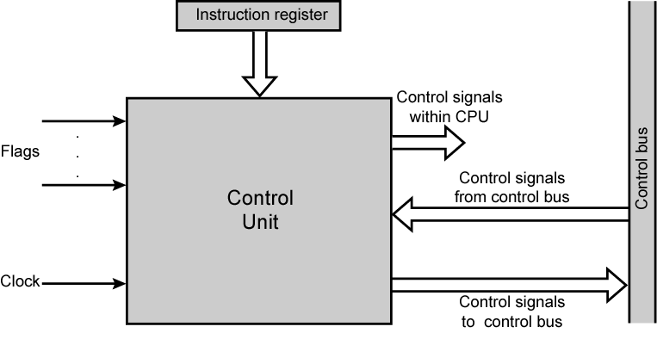
Model of Control Unit

Slide 24
Example of Control Signal Sequence - Fetch
  MAR ← (PC)
    Control unit activates signal to open gates between PC and MAR, see fig.16.5, pp465
  MBR ← (memory)
  Simultaneously (t1,t2)
    t1:
      Open gates between MAR and address bus(c0)
      Memory read control signal is on the control bus
    t2:
      Open gates between data bus and MBR, data →MBR (c5)
      Control makes PC add 1 and store the result back to PC (c3)

Slide 25
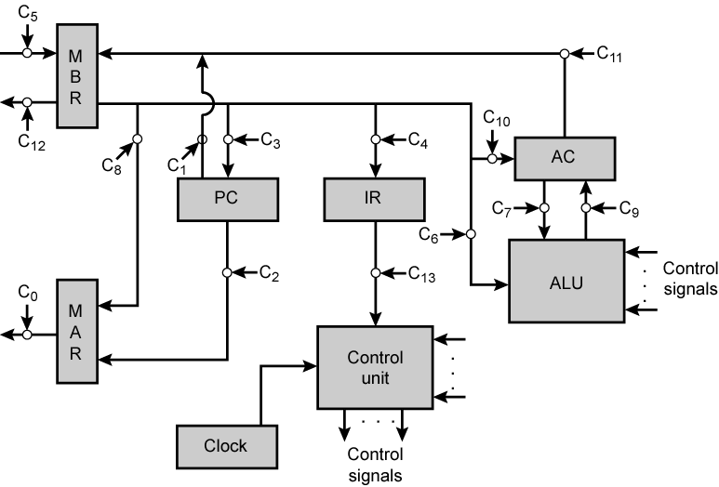
Data Paths and Control Signal
Data
bus
Address
bus
ADD X
（X）+AC－>AC

Slide 26
Another Control Signal Example
  Fig.16.5 is a simple processor with an accumulator
  With each clock pulse, the control unit reads all of its inputs
    Clock
    Instruction
    Flags
    Control bus
  And emits a set of control signals to:
    Data paths : control internal flow of data
    ALU: control the operation of ALU
    Control bus
  Causes micro-operations to occur
  Table 16.1 presents control signals needed by some micro-ops

Slide 27
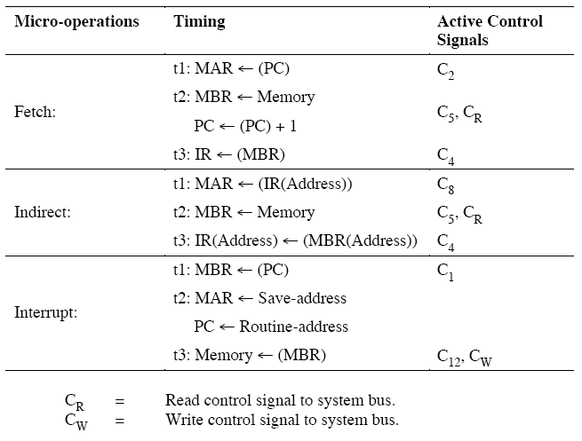
Micro-operations and Control Signals

Slide 28
Several Conclusions on the Control Unit
  The control unit is the engine that runs the entire computer
  It controls everything with a few controls
  Sequencing micro-ops
  Execute some micro-ops

Slide 29
Internal Processor Organization
  In CPU, Usually a single internal bus exists
    ALU and registers are connected, see fig.16.6
    Simplify interconnection & save space
  Gates control movement of data onto and off the bus
  Control signals control data transfer to and from external systems bus
  Temporary registers may be needed for proper operation of ALU, except for AC
    Input register: Y
    Temporary output register: Z

Slide 30
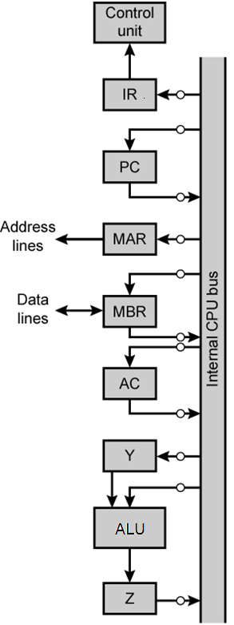
CPU with
Internal
Bus
ADD X
（X）+AC－>AC

Slide 31
16.3 Hardwired Implementation
Implementation of Control Unit
  Implementation methods of control unit can be classified into two categories
    Hardwired implementation
    Micro-programmed implementation
  In a hardwired implementation, the control unit is essentially a combinatorial circuit
  Micro-programmed implementation is the topic of Chapter 17

Slide 32
Control unit inputs
  Flags and control bus signals
    Each bit means something, e.g. overflow
  Instruction register
    Op-code causes different control signals for each different instruction
    Unique logic for each op-code
    Decoder takes encoded input and produces single output
    a decoder has n binary inputs and 2^{n} outputs, each output actives a kind of controls
      See table 16.3

Slide 33
Clock
  Repetitive sequence of pulses
  Useful for measuring duration of micro-ops
  Must be long enough to allow signal propagation
  Different control signals emitted at different time within instruction cycle
  Need a counter with different control signals for t1, t2 etc.

Slide 34
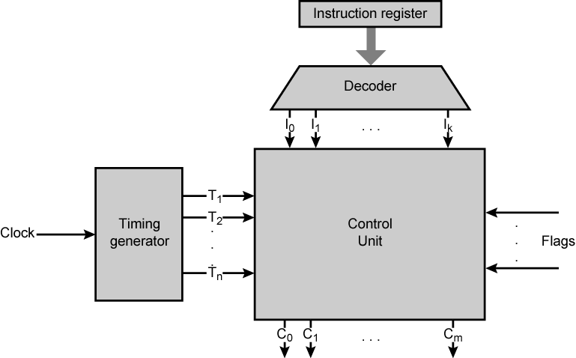
Control Unit with Decoded Inputs

Slide 35
Control Unit Logic
  Output control signal is a function of input control signals
    See Fig 16.10
  This function can be expressed by Boolean expression
  Boolean expression is implemented in combinational circuit
  Hardware circuit implementing the control unit is rather complex
  A simpler approach is micro-programming

Slide 36



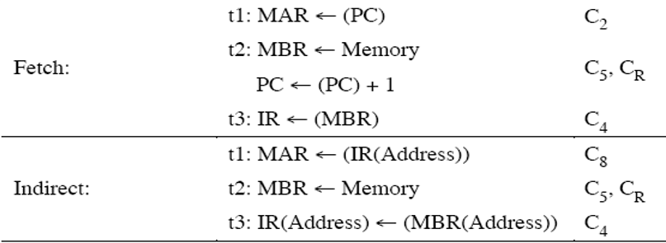
Define two new control signals, P and Q
  PQ= ICC
    00: fetch
    01: indirect
    10: execute
    11: interrupt

Slide 37
Advantages with Hard Wired Designs
  Control unit is viewed as a combinatorial logic circuit, used to generate fixed sequences of control signals
  Implemented using any of a variety of “standard” digital logic techniques
  Principal advantages:
    High(er) speed operation
    Suitable for smaller implementations
    Favored approach in RISC style designs

Slide 38
Problems With Hard Wired Designs
  Complex sequencing & micro-operation logic
  Difficult to design and test
  Inflexible design
  Difficult to add new instructions

Slide 39
Key points
  Concept of micro operation
  Model and organization of control unit
  Implementing modes of CU

Slide 40
Homework
某计算机字长16位，采用16位定长指令字结构，部分数据通路结构如图所示。图中所有控制信号为1时表示有效、为0时表示无效，例如控制信号MDRinE为1表示允许数据从DB打入MDR，MDRin为1表示允许数据从总线打入MDR。假设MAR的输出一直处于使能状态。加法指令“ADD(R1), R0”的功能为(R0) + ((R1)) ->(R1)，即将R0中的数据与R1的内容所指主存单元的数据相加，并将结果送入R1的内容所指主存单元中保存。

Slide 41
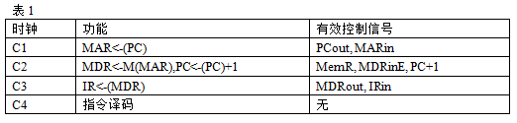
表1给出了上述指令取指和译码阶段每个节拍（时钟周期）的功能和有效控制信号，请按表1描述方式用表格列出指令执行阶段每个节拍的功能和有效控制信号。

Slide 42
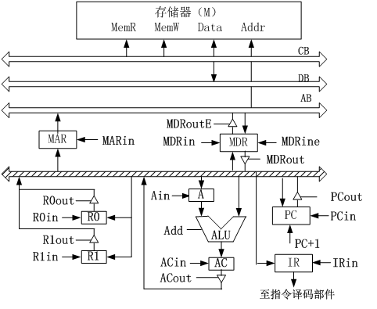
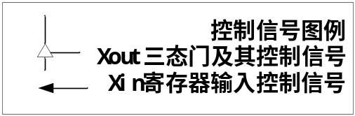

Slide 43
CPU结构如下图所示，其中有一个累加寄存器AC、一个状态条件寄存器和其他4个寄存器，各部件之间的连线表示数据通路，箭头表示信息传送方向。
（1）标明4个寄存器的名称。
（2）简述指令从主存取出送到CPU的数据通路。
（3）简述数据在CPU和主存之间进行存取访问的数据通路

Slide 44
